Slide 1



E-commerce Risk Of Credit Card Frauds & Data Mining Role In This Risk
By : hussein fawaz - M2 DSRA 2021
FOR : DR. Maguy Medlej
23-12-2021

Slide 2
Content
Define the topic - E-commerce
Possible risks in E-commerce
Risk of credit cards frauds
Random forest
Application of random forest in credit card frauds
Critical evaluate
Conclusion

Slide 3

What is E-commerce
The term electronic commerce (E-commerce) refers to a business model that allows companies and individuals to buy and sell goods and services over the internet.

Slide 4

What Are The Possible Risks Of E-commerce Business ?
Online security breach
Client disputes and refunds
Violation of intellectual property
Credit cards scams
Poor customer service
Weak authentication methods

Slide 5
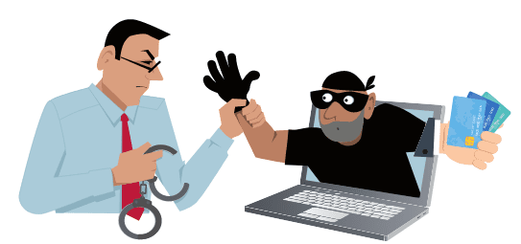
Define Credit Frauds in e-commerce
Credit card fraud is when someone makes an unauthorized purchase with credit card information that isn't theirs.

Slide 6

Data Mining Applied In This Risk

Slide 7

Challenges Involved in credit card fraud detection
Enormous data is processed every day
Imbalanced data
Data availability
Misclassified data
Adaptive techniques used against the model by the scammers

Slide 8

How To Tackle These Challenges
The model used must be simple and fast
Use some techniques to deal with imbalance data
Reduce dimensionality for protecting the user privacy
Take a more trustworthy source, for double-checking the data

Slide 9
Credit Card Fraud Detection System
Customer Transaction DB
Incoming Transaction
Fraud Detection system
Fraud Detection Algorithm
Find The Pattern
Algorithm Output
1
Fraudulent Transaction
0
Allow Transaction
Alarm Bank To Stop Transaction

Slide 10
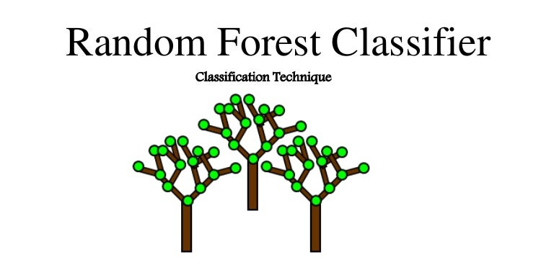

Slide 11
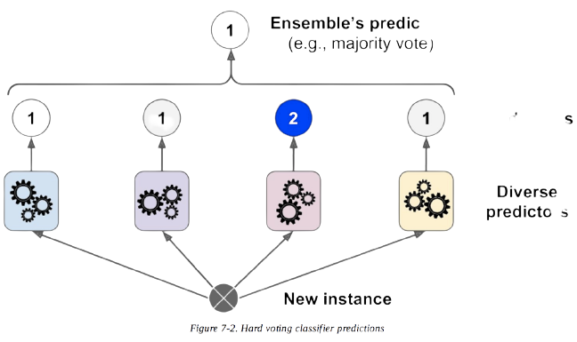
What is Random Forest
tion
It’s a supervised learning technique
Used for both classification and regression problems
Based on the concept of ensemble learning
prediction

Slide 12

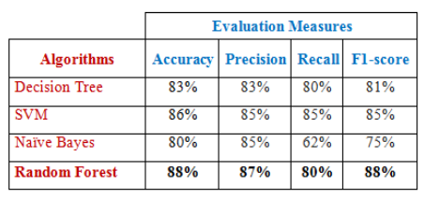
Why Choosing Random Forest
It's used a lot in banking, the stock market, medicine, and e-commerce
Get better results than other algorithms

Slide 13
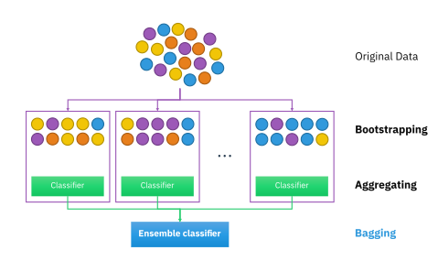
How Random Forest Work
Random forest works on the bagging principle.
It’s composed of two parts:
Bootstrapping
Aggregation

Slide 14
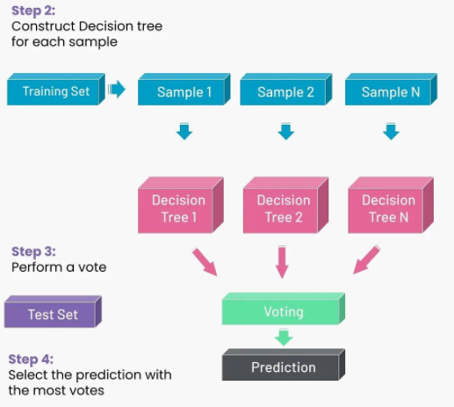
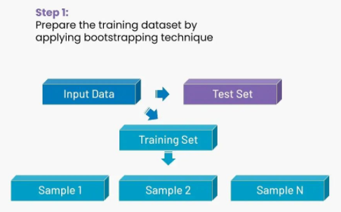
How Random Forest Work
Steps involved in random forest algorithm:

Slide 15

Random Forest Applied In Credit Cards Fraud Detection
1. Understanding the dataset
“Credit card fraud detection” dataset on [kaggle.Com]
Transactions were made in September 2013, by European credit card holders
Shape of the data 284807 entries and 31 columns

Slide 16
Random Forest Applied In Credit Cards Fraud Detection
2. FEATURES DESCRIPTION
Features | Description
V1 .. V28 | Masked using principal component analysis (PCA) due the sensitivity of data
Amount | Total transaction value
Time | The seconds elapsed between the current transaction and the first transaction in the dataset
Class labels | 1 For fraudulent cases - 0 for non-fraudulent cases

Slide 17
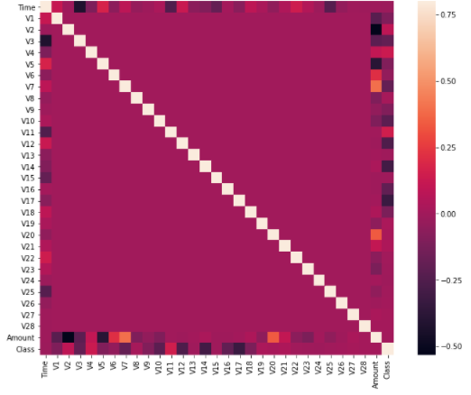
Random Forest Applied In Credit Cards Fraud Detection
3. DESCRIBING THE DATASET
There is only 0.17% fraudulent transaction out all the transactions. The data is highly Unbalanced.
Fraud Cases : 492
Valid Transaction : 284315
Correlation matrix

Slide 18
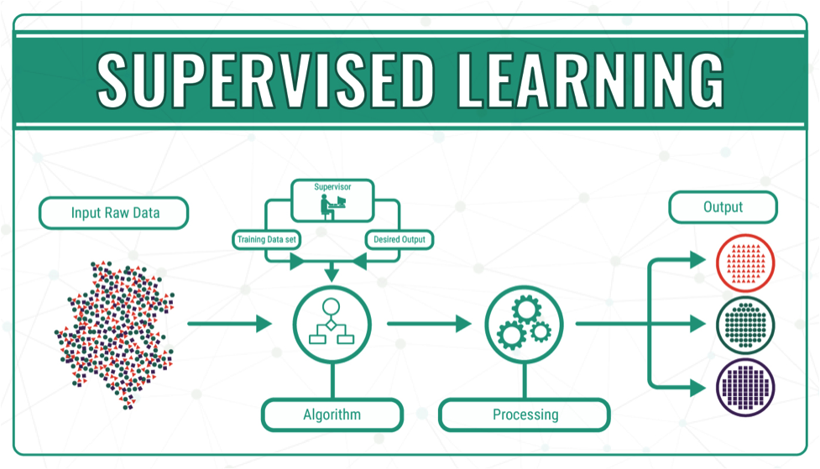
Random Forest Applied In Credit Cards Fraud Detection
4. BUILDING THE RANDOM FOREST MODEL
Splitting of the data set into training and test set
Applying RFA and classifying dataset
Perform analysis for finding accuracy

Slide 19

Random Forest Applied In Credit Cards Fraud Detection
5. Model Result
Evaluation Metrics | Result
ACCURACY | 0.99
RECALL | 0.73
F1-SCORE | 0.83
PRECISION | 0.94

Slide 20
Critically evaluate
But all this work has been done on an imbalanced dataset but we got a satisfactory result but not suitable. So if we can use some techniques to deal with imbalanced classes such as k-fold cross-validation, resample the training set, or cluster the abundant class, it can give us more improved evaluation measures.

Slide 21
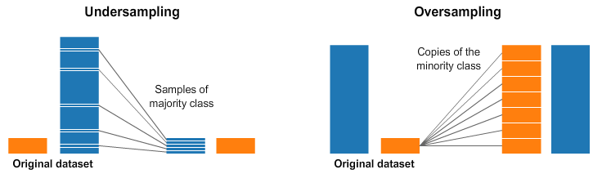
Model Improvement using Sampling Techniques
Sampling Techniques Used :
Undersampling
Oversampling
Confusion Matrix
101 | 5
8 | 85
Model result after applying undersampling
Evaluation Metrics | Result
ACCURACY | 0.94
RECALL | 0.93
F1-SCORE | 0.94
PRECISION | 0.94

Slide 22
Conclusion
This field needs so much more research and this is one of the topics where an increase in specificity by 0.1% will save millions, if not billions of dollars.

Slide 23
Resources
https://medium.com/analytics-vidhya/credit-card-fraud-detection-in-python-using-scikit-learn-f9046a030f50
https://dataaspirant.com/credit-card-fraud-detection-classification-algorithms-python/#t-1600792769587
(PDF) CREDIT CARD FRAUD DETECTION USING DATA MINING TECHNIQUES (researchgate.net)
Credit Card Fraud Detection Using Random Forest Algorithm | IEEE Conference Publication | IEEE Xplore
Fraud Detection in Credit Card Transactions using Anomaly Detection | Turkish Journal of Computer and Mathematics Education (TURCOMAT)
https://dataaspirant.com/credit-card-fraud-detection-classification-algorithms-python

Slide 24


